Slide 1
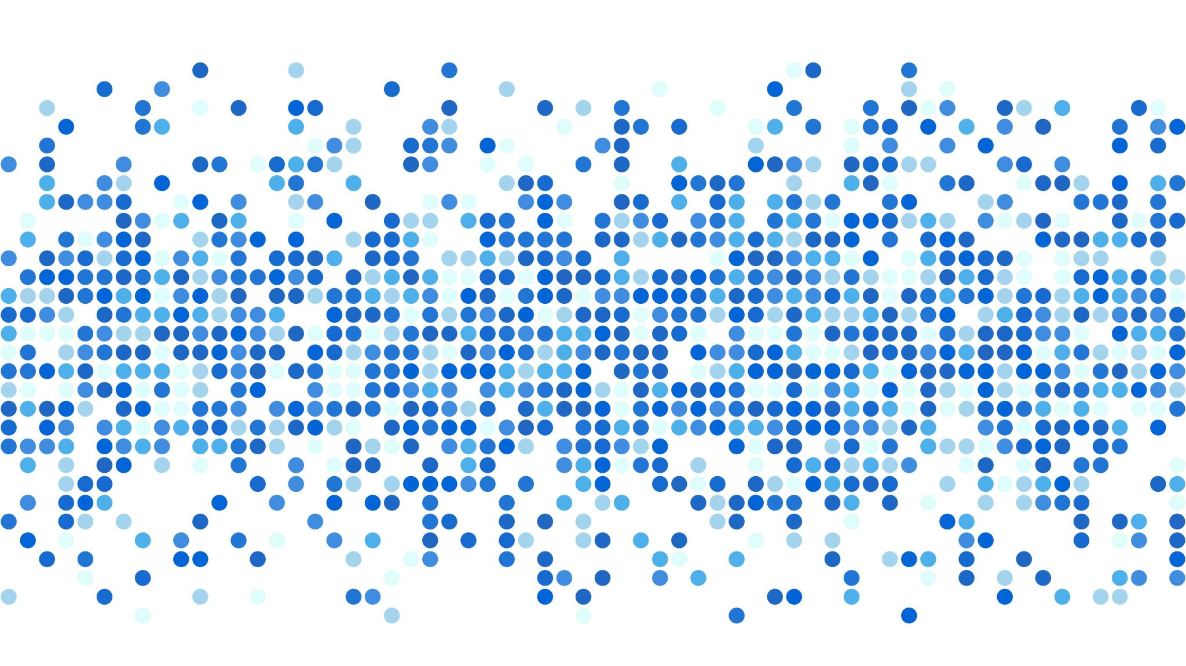
Equality compare
Unit 17

Slide 2
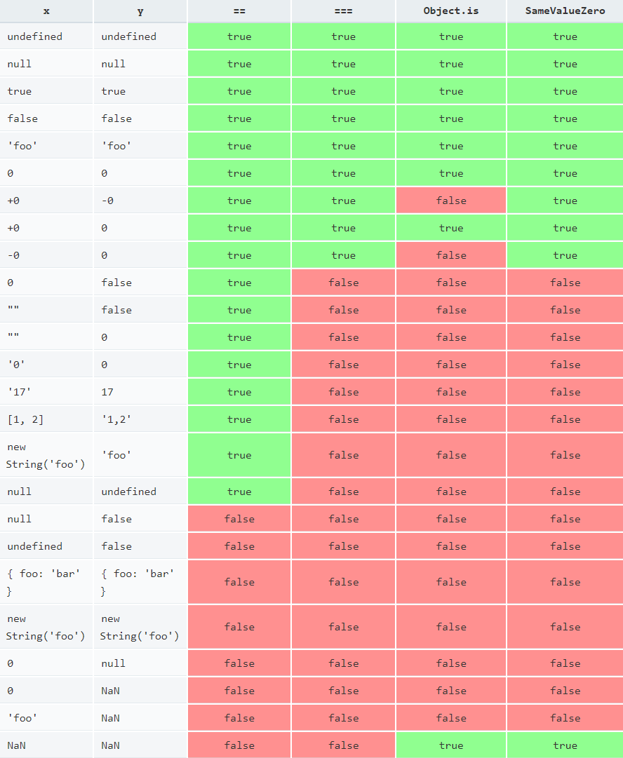
JavaScript different ways to compare

